Slide 1
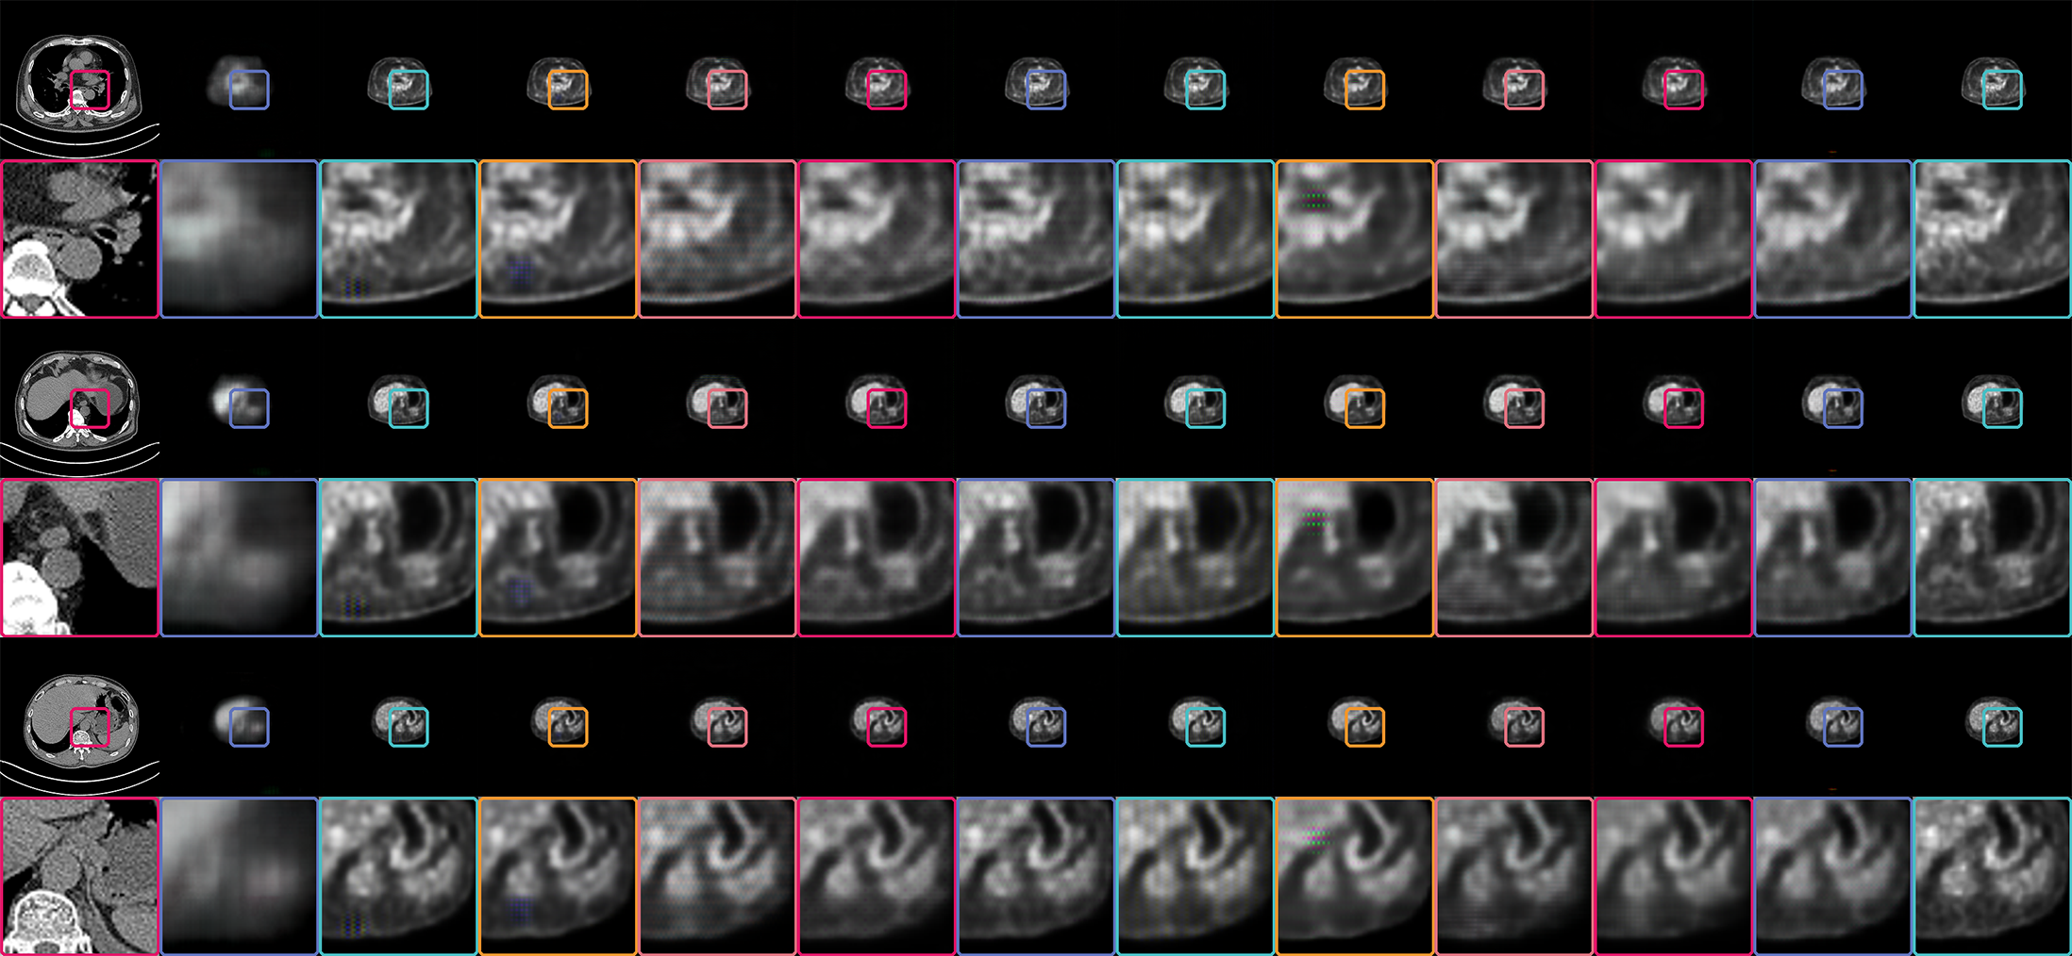
CT
DSGGAN
Stage01
Stage02
Stage03
Stage04
Stage05
Stage06
Stage07
Stage08
Stage09
Stage10
Real PET

Slide 2
CT
DSGGAN
Stage01
Stage02
Stage03
Stage04
Stage05
Stage06
Stage07
Stage08
Stage09
Stage10
Real PET

Slide 3






CT
DSGGAN
U-Net
Cas-Unet
Stage03
Stage04
Stage05
Stage06
Stage07
Stage08
Stage09
Stage10
Real PET

